Slide 1
PSCS_46_Application for Assessment of Quality of Textbook/ Reference Books/E-Books
CSE7101- Capstone Project
Review-2
Batch Number : CSE_23
Under the Supervision of,
Dr./Mr./Ms./Prof. Ms.Kummara Sruthi &
Ms.Shweta Singh
Professor / Associate Professor / Assistant Professor
School of Computer Science and Engineering
Presidency University
20221CSE0234 | Syed Thousif
20221CSE0213 | Patil Jashwanth Reddy
20221CSE0211 | Kambam Nithin Kumar Reddy
Roll Number | Student Name
Name of the Program : School of Computer Science & Engineering
Name of the HoD : Dr. Asif Mohammed
Name of the Program Project Coordinator : Dr.Jayavadivel Ravi , Mr. Muthuraju V
Name of the School Project Coordinators : Dr.Sampath A K , Dr. Geetha A

Slide 2
Problem Statement Number : PSCS_46
Organization: Ministry Of AYUSH
Category (Hardware / Software / Both) : Software
Problem Description : The medical students aiming to be good physicians, need to select a standard medical textbook. It is evident that there are several books made available in ASU (Ayurveda, Unani, Siddha) medical systems and every book claims that the book has been written as per CCIM or NCISM syllabus. Amongst some are good and some are of poor quality and were written with vested interest. Due to this, students are trapped by substandard books that leads to poor quality standard among students. Identifying this issue and its impact on medical on the medical system, NCISM constituted an expert committee for the development of an assessment scale for textbooks/ reference books. The expert committee after thorough deliberations developed the assessment scale for the quality assessment of textbooks/ reference books. This assessment scale serves the purpose of:- Selection of quality textbooks by teachers for their students. Serving as a reference for textbook writers. Providing criteria to recommend for inclusion in the list of recommended apex/ regulatory bodies. The assessment process requires a review of the books by reviewers (subject-wise reviewers located across the country, 3 reviewers per book) and summarizing the reviewer's remarks and decision by the committee. The development of an application on this will help to get reviews from people around the world online and also will help to summarize all the reviewed data in a faster mode.:

Slide 3
Content
Abstract
Literature survey
Objectives
Drawbacks /Existing Methods
Proposed Method & Feasibility Study
Architecture Diagram
Modules
Hardware & Software Details

Slide 4
Abstract
Our project focuses on creating an online platform to evaluate and ensure the quality of textbooks and e-books before they are published. Its primary goal is to verify that every textbook meets a defined minimum standard before entering the market. The system allows authors to submit their work for review, where it is assessed by experts based on factors such as accuracy, relevance, and readability. By implementing this pre-publication review process, the platform helps prevent low-quality or outdated books from reaching students and educators. This ensures that only reliable and well-structured learning materials are published, ultimately improving educational outcomes and promoting higher standards in academic publishing.

Slide 5
Literature Survey
Author(s) & Year | Title | Methodology / Framework | Limitations / Gaps
Dr. Ambika L G S et al. (2024) | Quality Textbook Assessment System (QTAS) | Used Random Forest ML algorithm with book reviews dataset (Kaggle). Preprocessing with TF-IDF, trained with 80/20 split. | Focused mainly on reviews; limited integration with structured rubrics and subject standards.
Liu Gang (2024) | Research on the Quality Evaluation Method of College Textbooks | Developed a multi-level evaluation index system including content quality, ideological value, applicability, publishing quality. Data collected via surveys of teachers & students. | Relies heavily on subjective surveys; lacks AI-based automation and cross-validation.
Yambi, T. A. C. (2020) | Assessment and Evaluation in Education | Conceptual distinction: Assessment (formative, process-oriented) vs. Evaluation (summative, outcome-based). Reviewed principles of reliability, validity, objectivity. | Did not propose a concrete framework for textbooks specifically.
NCISM (2023) | Textbook Quality Assessment Scale (Medical Texts) | Rubric-based evaluation: Author credibility, publisher credibility, subject matter, physical structure, illustrations, language. Scoring out of 352 with thresholds for Grade I/II. | Focused on medical textbooks; lacks adaptability across general education fields.

Slide 6
Objectives
To design an online platform where textbooks and e-books can be reviewed before publishing.
To make sure every book meets basic standards of accuracy, clarity, and relevance.
To provide a space where experts can review and guide authors in improving their work.
To reduce the chance of poor-quality or outdated books reaching students and teachers.
To support better learning by ensuring only well-structured and reliable materials are published.

Slide 7
Drawbacks & Overcome
Drawbacks | Ways to Improve
Relies too much on online reviews | Take feedback directly from teachers and students who actually use the books.
Focuses more on star ratings than the real content | Check how well the book matches the syllabus and whether the concepts are clear.
Accuracy shown in results may not work everywhere | Try the system on different kinds of books with more variety of data.
Not tested enough in real classrooms | Run pilot tests in schools and colleges to see how useful it really is.
AI models may carry hidden bias | Use balanced data and keep checking results regularly to avoid unfairness.

Slide 8
Proposed Method & Feasibility Study
Random Forest Algorithm - It splits your dataset into smaller parts and builds multiple decision trees (like multiple people giving opinions). - Each tree makes a prediction (a "vote"). - The algorithm then takes the majority vote as the final answer. What We Achieve Using Random Forest - Automates the evaluation process, reducing review time from weeks/months to just minutes or hours - Provides data-driven, unbiased decisions, ensuring fair and equal evaluation for every book - Evaluates books using multiple features like grammar, plagiarism, readability, and reviewer feedback - Ensures only books meeting quality standards are approved for publication

Slide 9
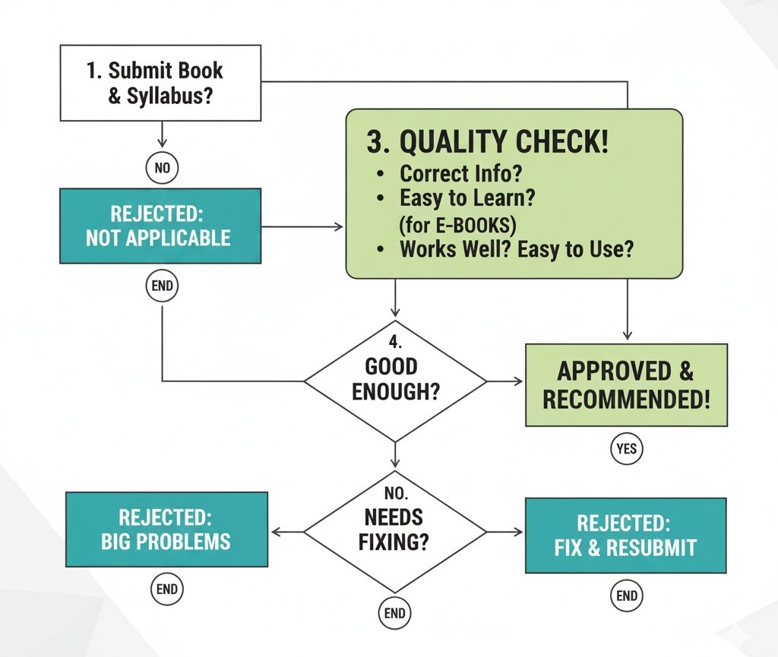
Architecture Diagram

Slide 10
Modules
1. Authentication (Login/Signup)
2. Book Information Submission
3. Assessment & Rating
4. File Upload (PDF of Book)
5. Reviewer Details
6. Final Submission

Slide 11
Hardware & Software Details
Hardware Requirements
Processor: Intel i3 or above
RAM: 4 GB (8 GB recommended)
Hard Disk: 250 GB or higher
Internet connection
Software Requirements
OS: Windows 10 / Linux
Programming: Python / html/CSS
Database: MySQL / SQLite
Tools: MS Office / PDF Reader / Web Browser

Slide 12
References (IEEE Paper format)
[1] Application for Assessment of Quality of Textbook/Reference Book/E-Books, International Journal of Engineering Innovations and Management Strategies, published circa early 2025 (about six months ago) IJEIMS.
[2] Q. Zhou, “Evaluating book impacts via integrating multi-source reviews,” Scientometrics, vol. 129, 2024
[3] R. K. Singh and A. Sharma, "Design and development of web-based evaluation system for academic resources," International Journal of Computer Applications, vol. 183, no. 8, pp. 25–30, June 2021.
[4] S. R. K. Somasekhar, P. V. Kumar, and R. J. Reddy, "Automated assessment of educational content using multi-criteria analysis," in Proc. IEEE International Conf. on Technology for Education (T4E), Mumbai, India, 2020, pp. 215–220.
[5] M. A. Al-Emran, "Towards an intelligent framework for textbook evaluation in higher education," Education and Information Technologies, vol. 24, no. 2, pp. 1453–1468, Mar. 2019.
[6] N. G. T. Izquierdo, L. A. G. Villalobos, and J. D. M. Ramírez, "A framework for the evaluation of e-learning materials," in Proc. IEEE Global Engineering Education Conf. (EDUCON), Abu Dhabi, UAE, 2016, pp. 1129–1134.
[7] T. M. Connolly and E. A. Stansfield, "Evaluating the quality of learning resources: A web-based approach," in Proc. IEEE International Conf. on Advanced Learning Technologies (ICALT), Athens, Greece, 2014, pp. 37–41.

Slide 13


